Slide 1
Vivado: A step by step guide
amr.alaa@guc.edu.eg
C3.305 (Back office)
Sandy.abdelmalak@guc.edu.eg
C3.207
1

Slide 2
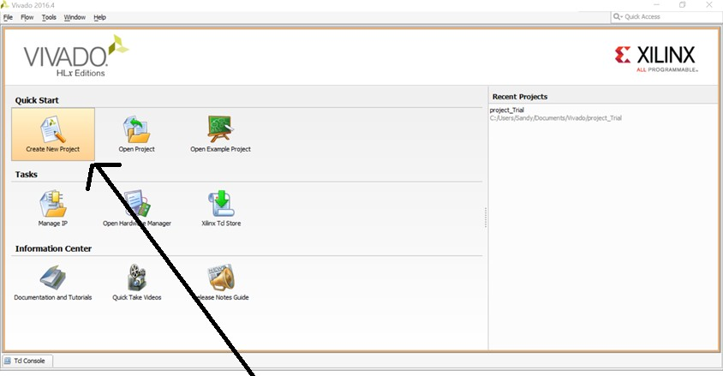
Creating a new project
2

Slide 3
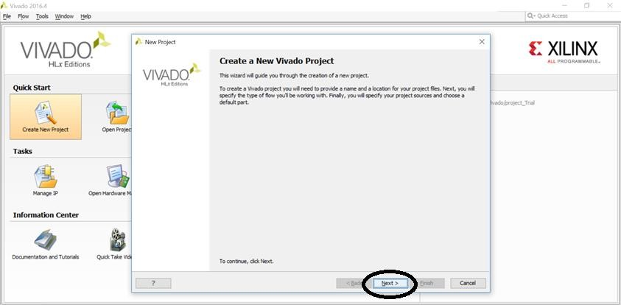
Creating a new project
3

Slide 4
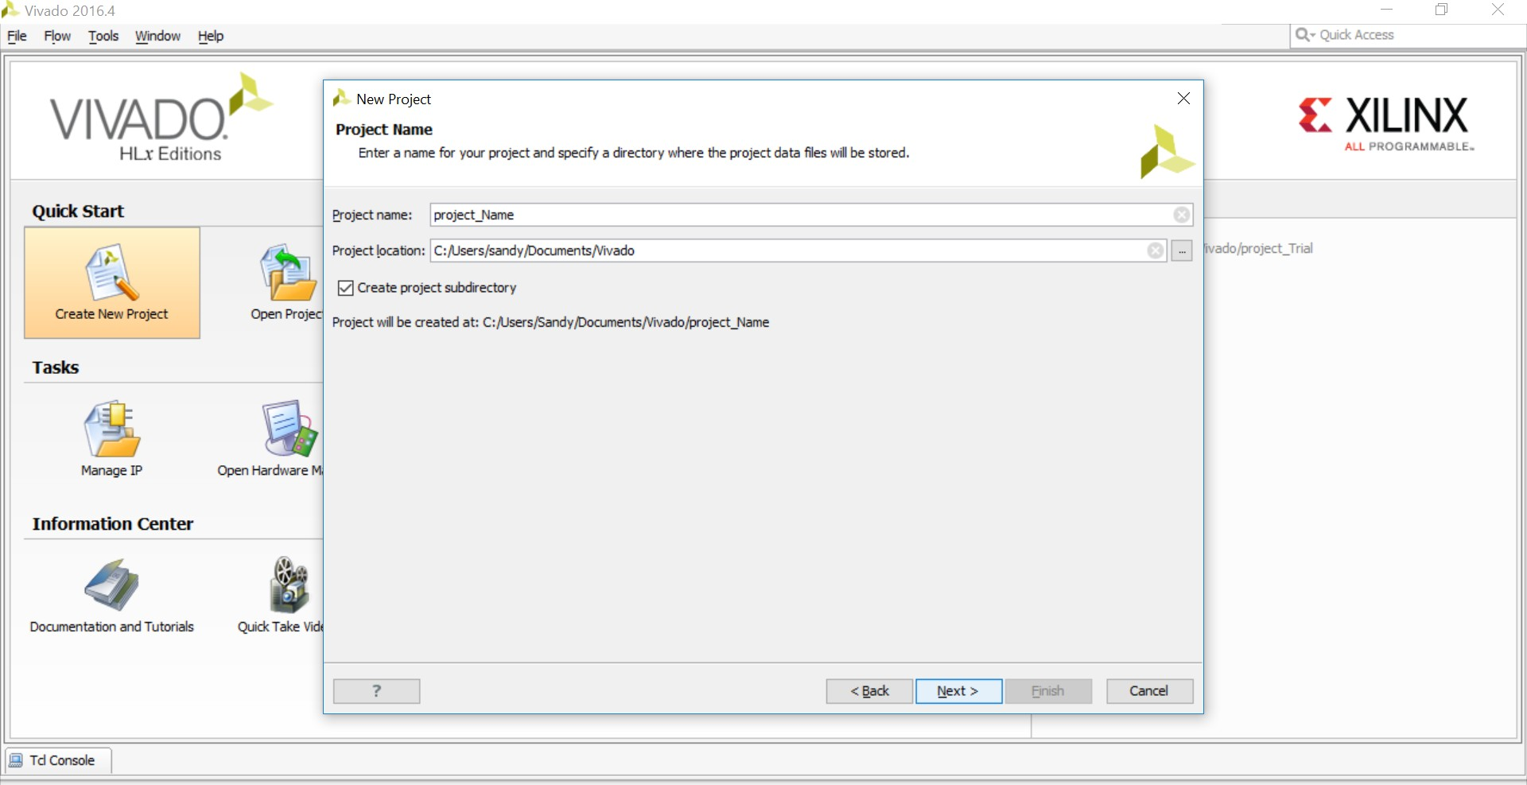
Creating a new project
Choose project name and directory then press next ₄

Slide 5
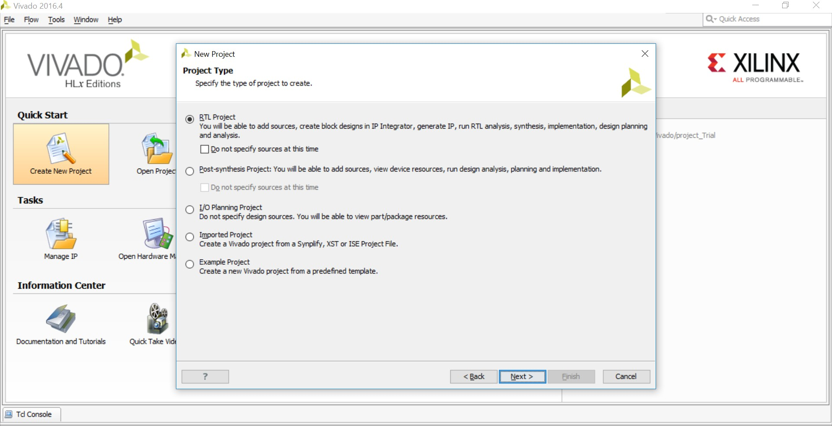
Creating a new project
Choose RTL project then press next
5

Slide 6
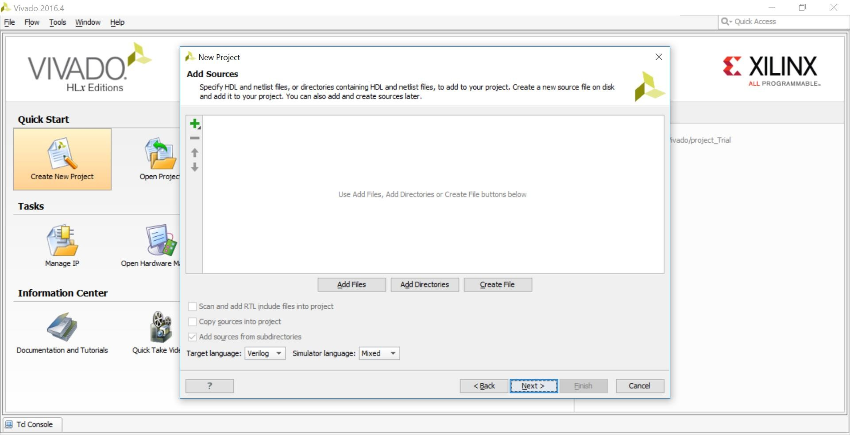
Creating a new project
Choose add files to add sources already existing
*Choose create files to create new sources
6

Slide 7
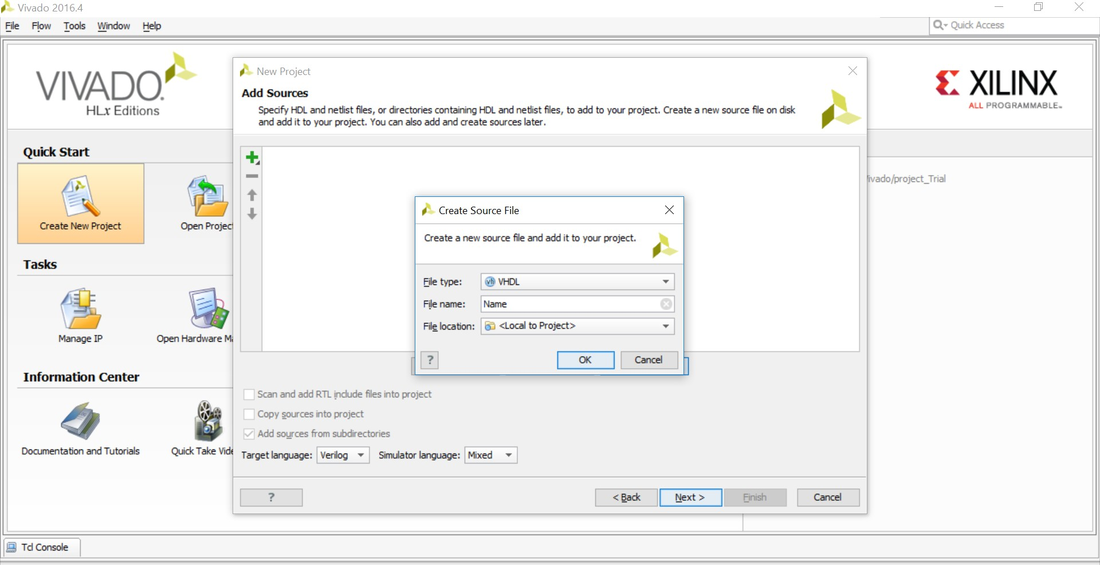
Creating a new project
If you choose to create a new file, then change the file type to VHDL and choose a name for your file and press OK
7

Slide 8
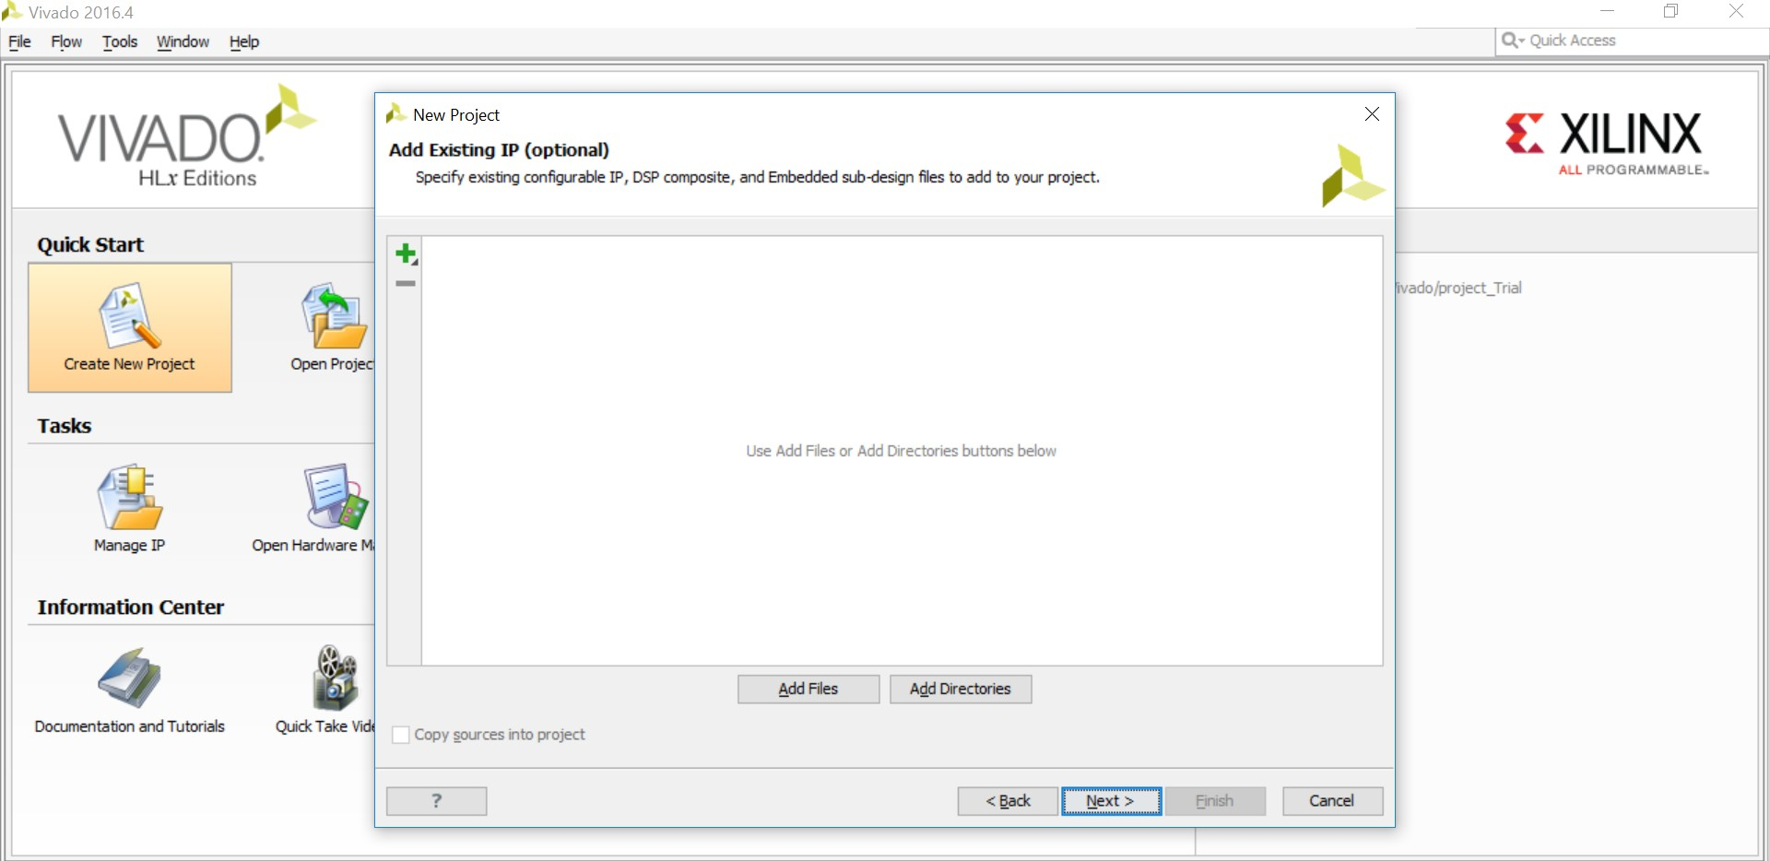
Creating a new project
Press next
8

Slide 9
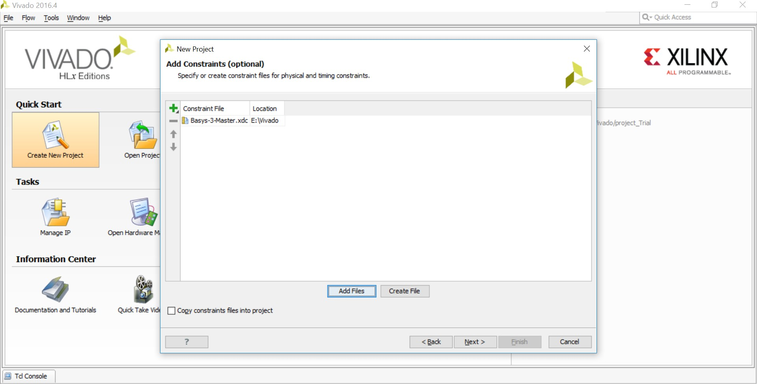
Creating a new project
Press add files then choose the constraints file of the Basys-3 board
9

Slide 10
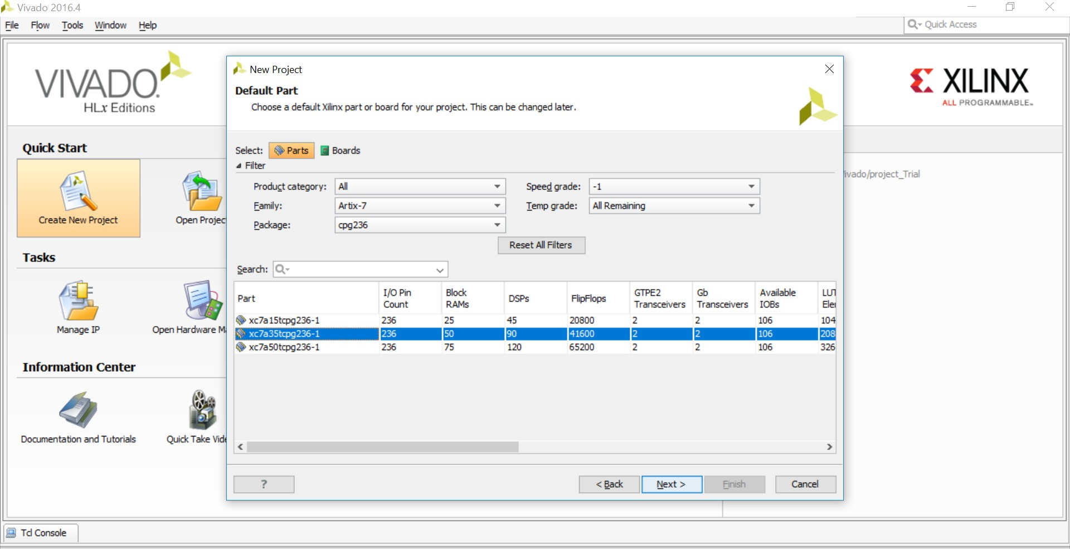
Creating a new project
Choose the board specs as shown for the Basys-3, then press next and finish
10

Slide 11
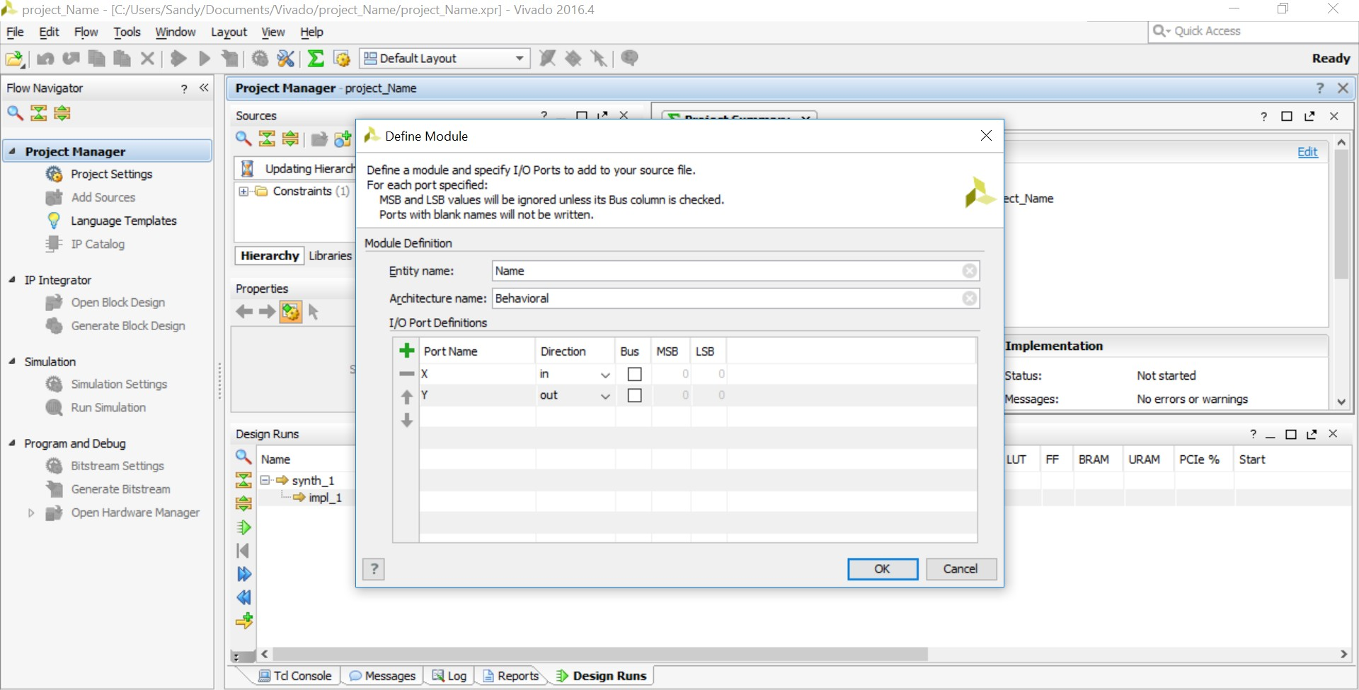
Define the Module
Define the inputs and outputs
11

Slide 12
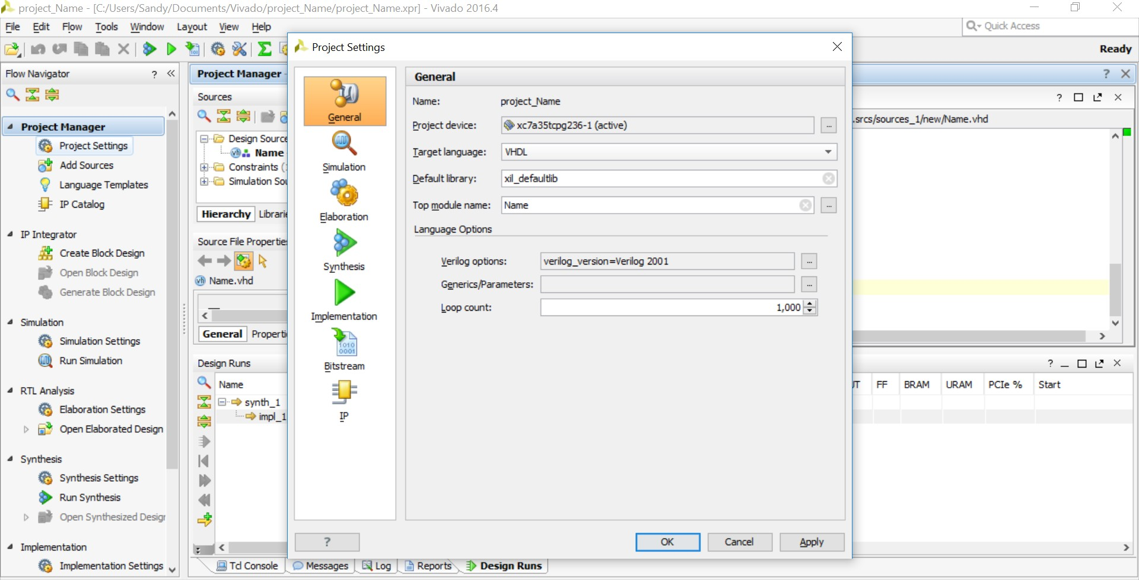
Choose VHDL
From project settings under the project manager choose VHDL as the target language
12

Slide 13
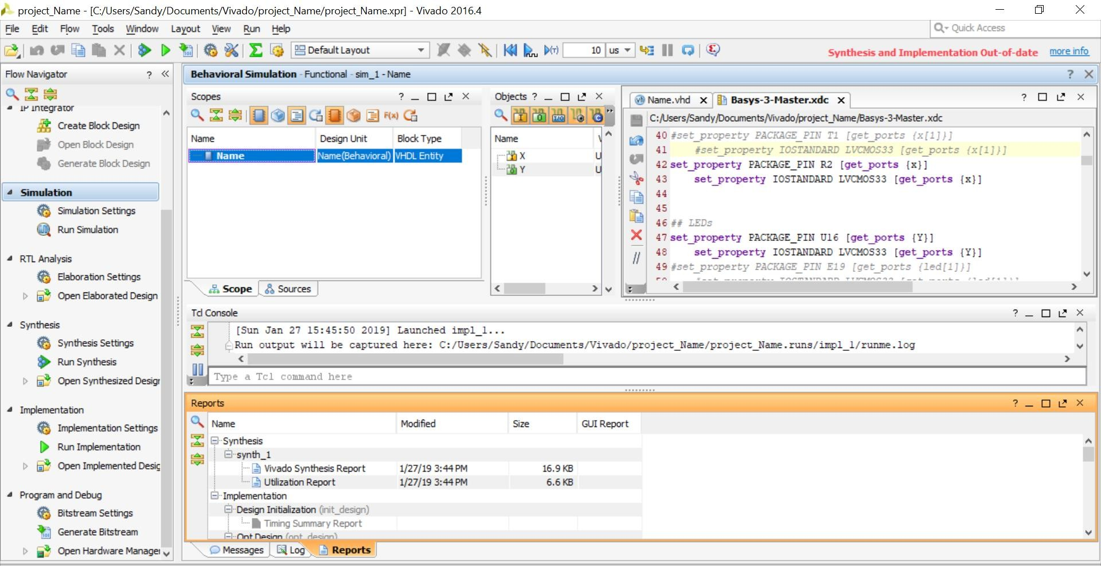
Constraints
When the code is done, update the constraints file by uncommenting the desired I/O pins and assigning the port names to the pins
13

Slide 14
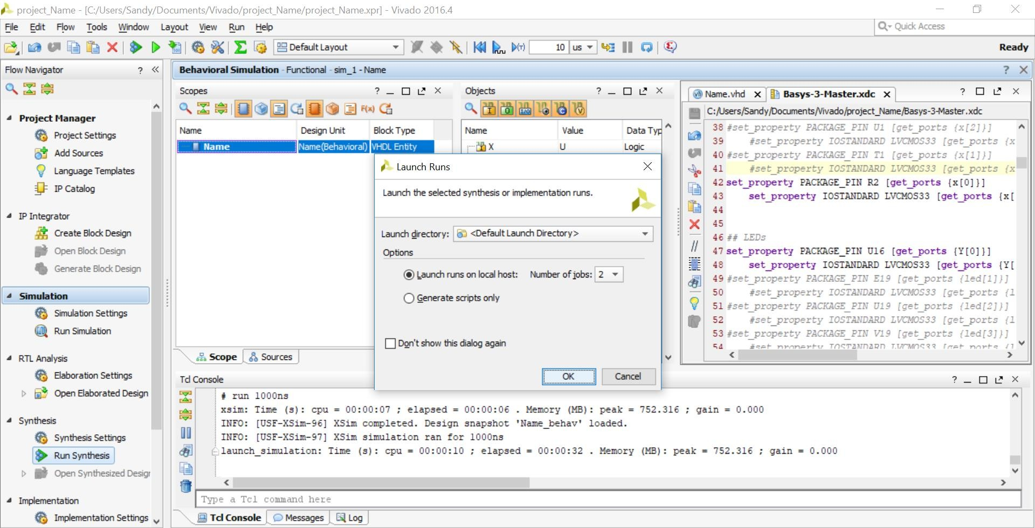
Run Synthesis
This takes 3-
5 minutes
Press run synthesis then press OK
14

Slide 15
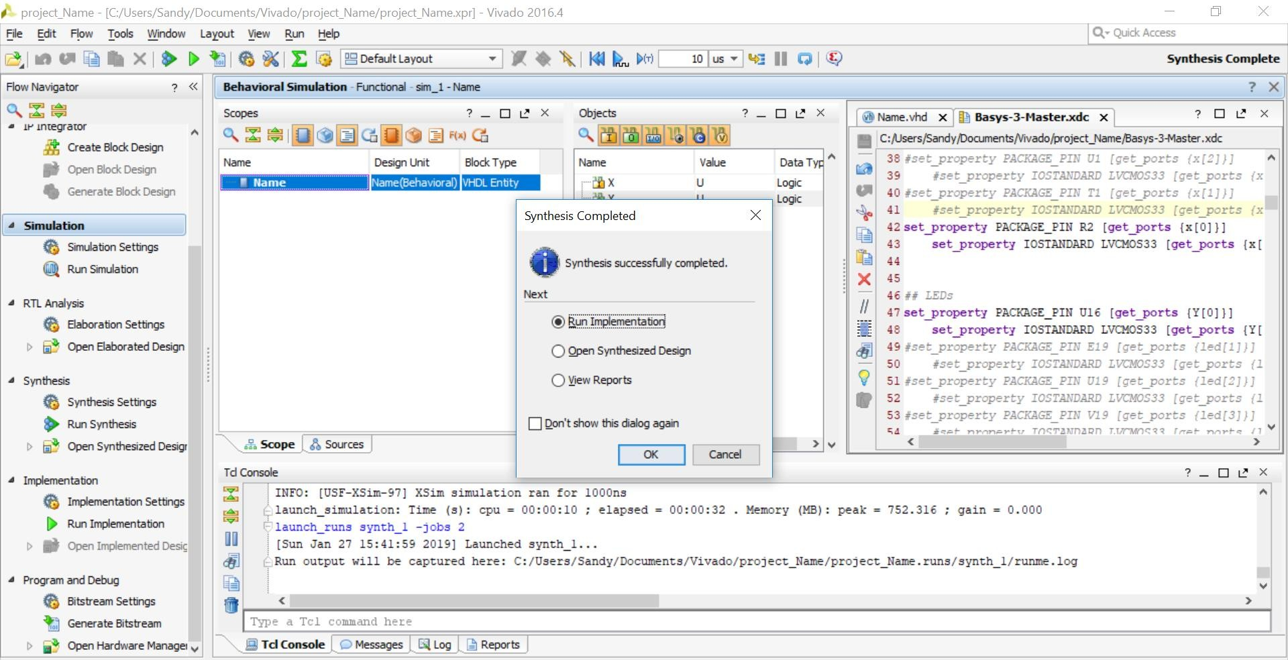
This takes 3-5
minutes
Run Implementation
c
Press run implementation then OK
15

Slide 16

Generate Bit stream file
This takes 3-5 minutes
Choose generate bitstream then press OK
16

Slide 17
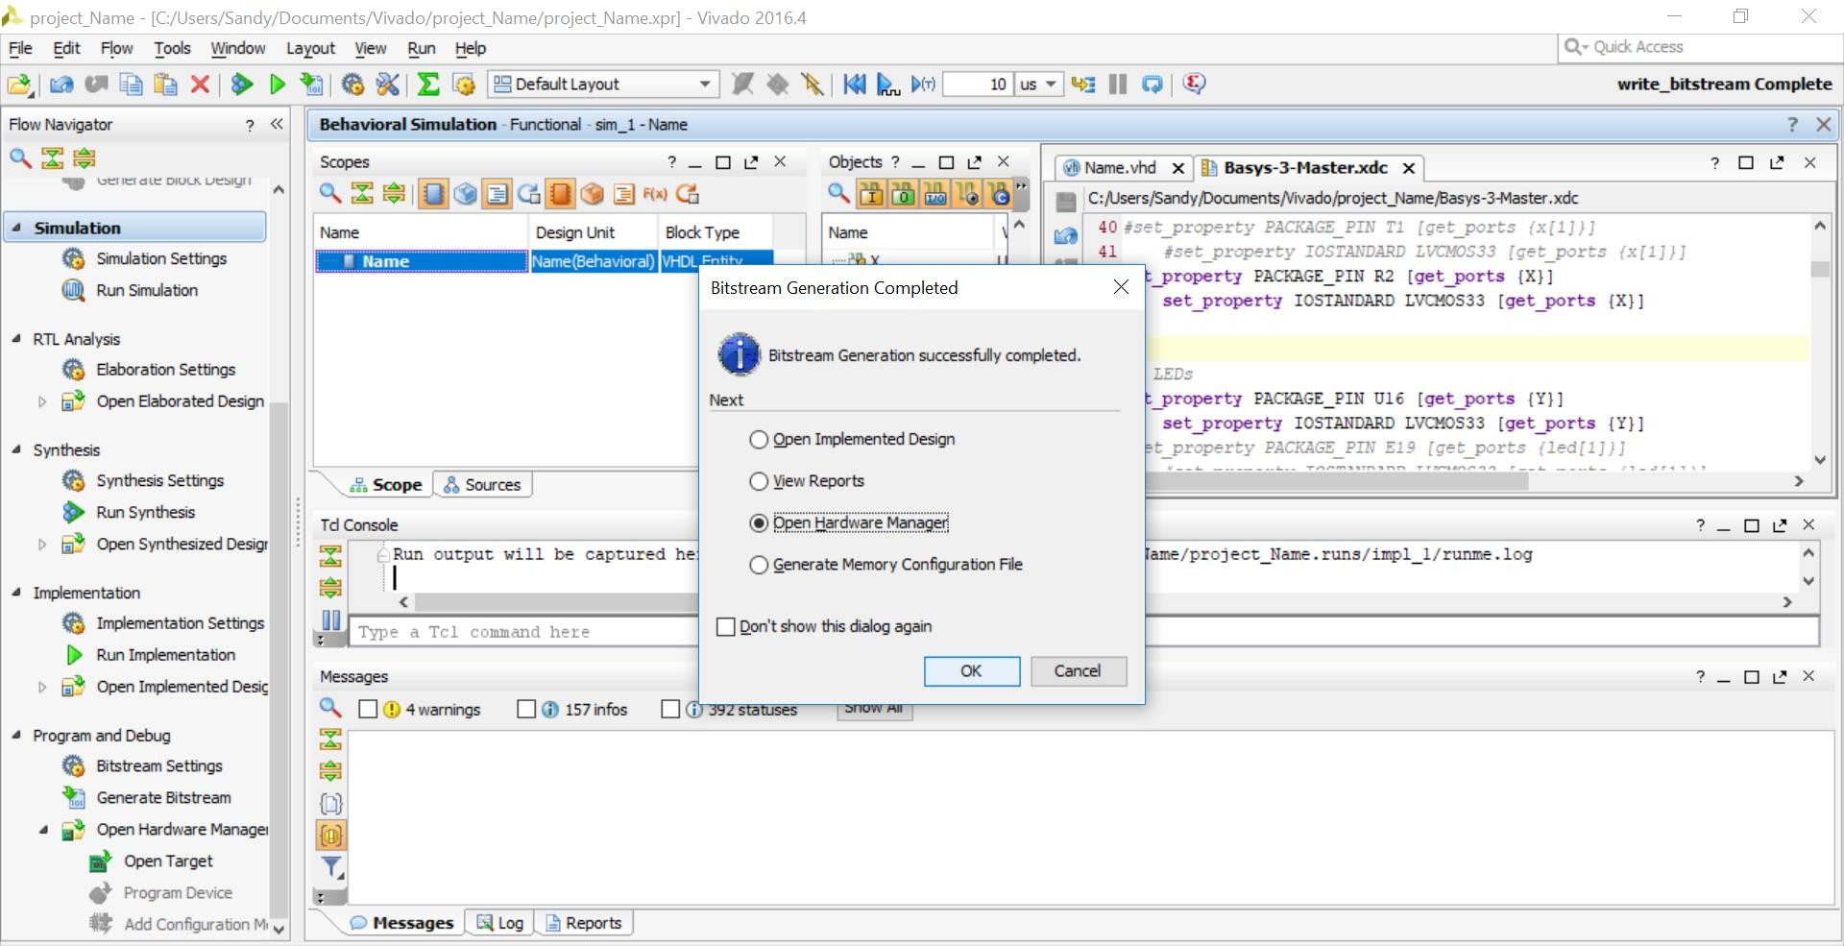
Selecting the board
Open the hardware manager then choose open target, and then open new target
17

Slide 18
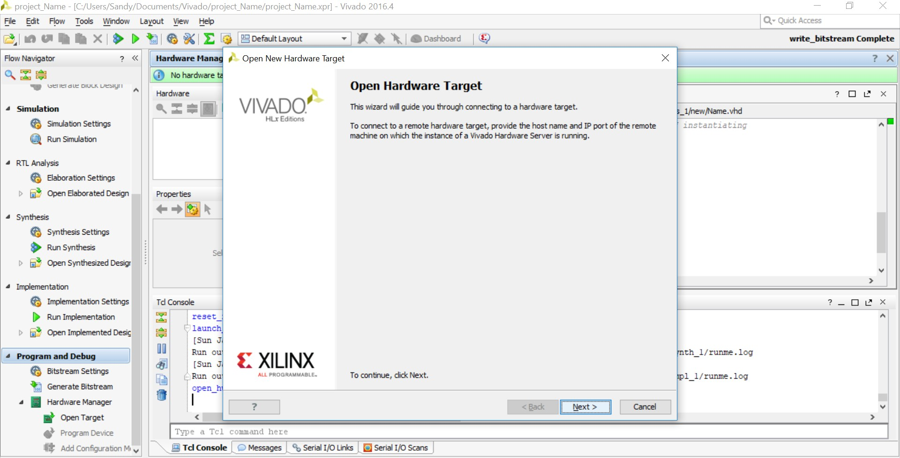
Selecting the board
Press next and make sure that the board is connected to your laptop
18

Slide 19
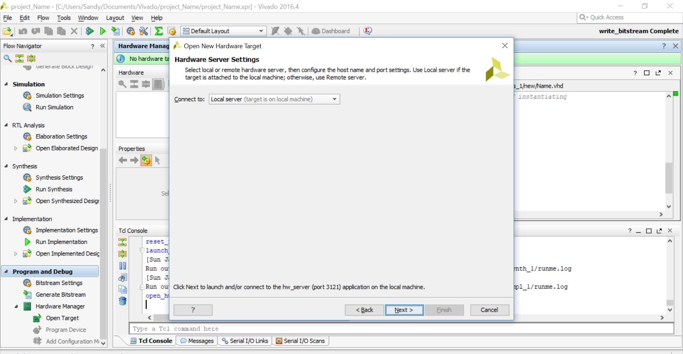
Selecting the board
Choose connect to local server then press next
19

Slide 20
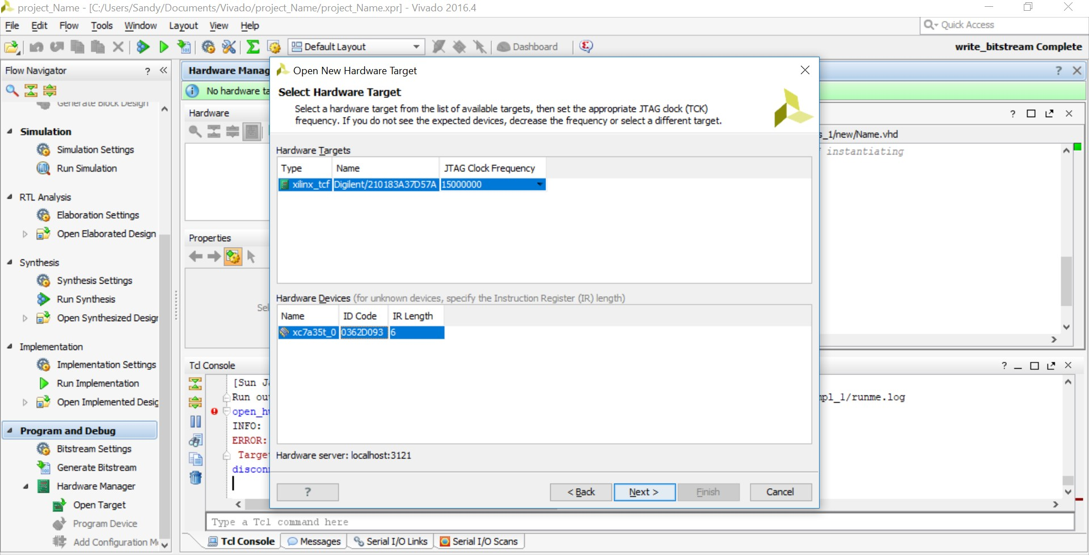
Selecting the board
Choose the board, then press next and finish, and finally select program device and press program
20

Slide 21
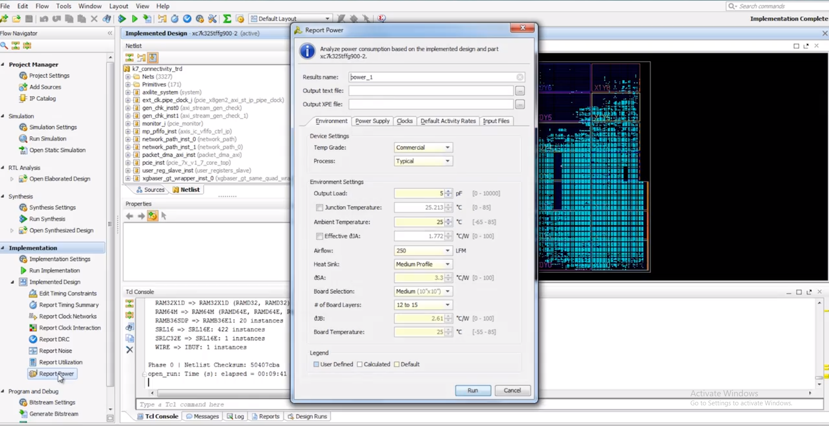
Power & Area Utilisation Reports
Run implementation, then press report power, and finally press run.
For the utilised area, choose report utilization.
20

Slide 22
Thank You
21

